Slide 1


CS 106: Artificial Intelligence
Constraint Satisfaction Problems
Instructor: Ngoc-Hoang LUONG, PhD.
University of Information Technology (UIT), VNU-HCM
[These slides were adapted from the slides of https://www.cs.upc.edu/~erodri/webpage/cps/cps.html]
Notes:
Please retain proper attribution, including the reference to ai.berkeley.edu. Thanks!

Slide 2
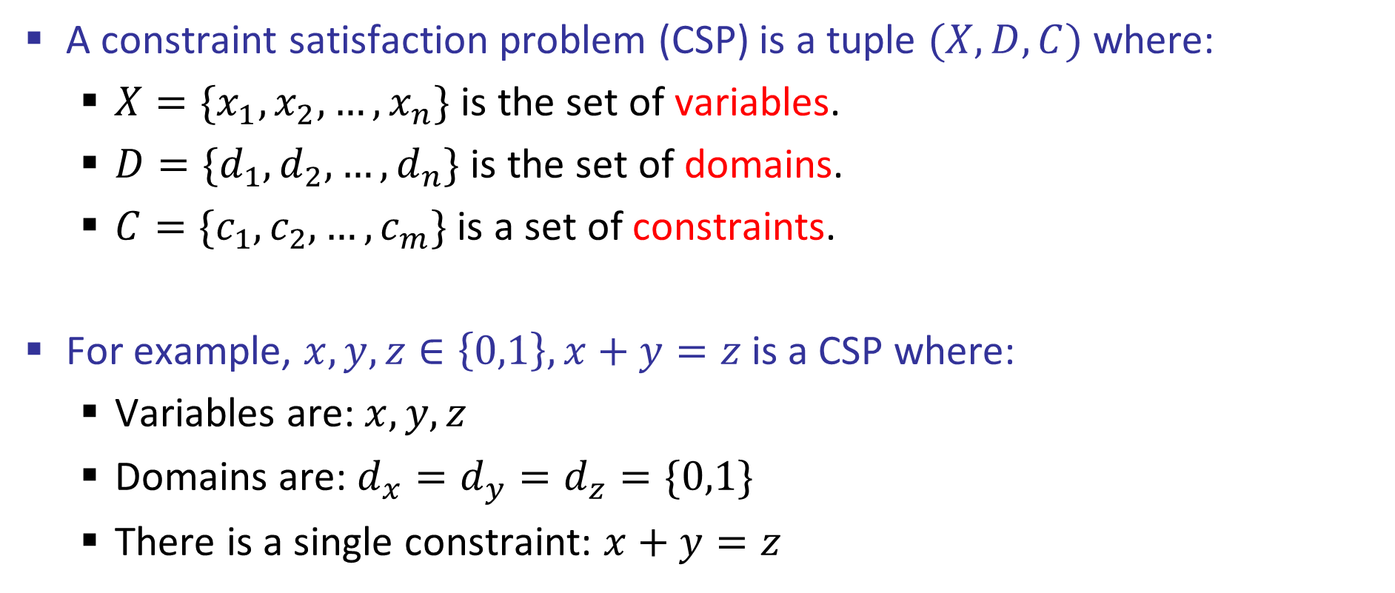
Constraint Satisfaction Problems
A constraint satisfaction problem (CSP) is a tuple $(X,D,C)$ where:
$X=\{x_{1},x_{2},…,x_{n}\}$ is the set of variables.
$D=\{d_{1},d_{2},…,d_{n}\}$ is the set of domains.
$C=\{c_{1},c_{2},…,c_{m}\}$ is a set of constraints.
For example, $x,y,z∈\left\{0,1\right\},x+y=z$ is a CSP where:
Variables are: $x,y,z$
Domains are: $d_{x}=d_{y}=d_{z}=\{0,1\}$
There is a single constraint: $x+y=z$
https://www.cs.upc.edu/~erodri/webpage/cps/cps.html

Slide 3
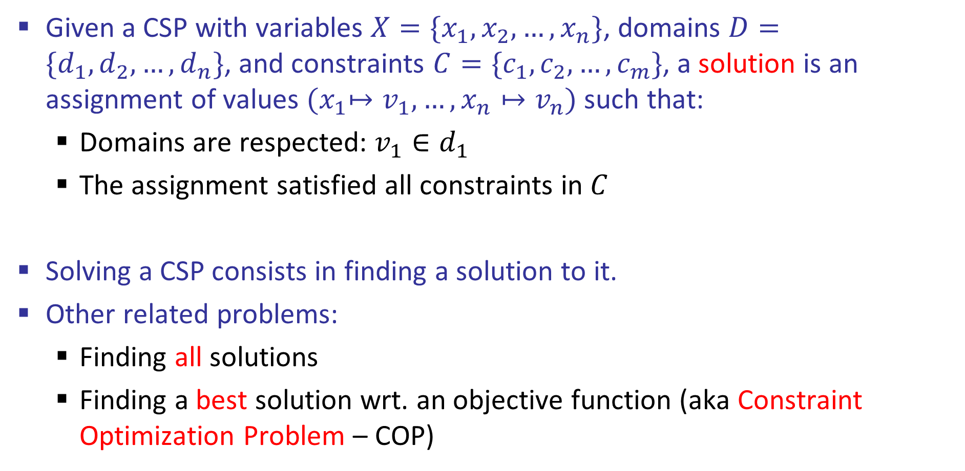
Solutions to CSPs
Given a CSP with variables $X=\{x_{1},x_{2},…,x_{n}\}$, domains $D=\{d_{1},d_{2},…,d_{n}\}$, and constraints $C=\{c_{1},c_{2},…,c_{m}\}$, a solution is an assignment of values ${(x}_{1}↦v_{1},…,x_{n}↦v_{n})$ such that:
Domains are respected: $v_{1}∈d_{1}$
The assignment satisfied all constraints in $C$
Solving a CSP consists in finding a solution to it.
Other related problems:
Finding all solutions
Finding a best solution wrt. an objective function (aka Constraint Optimization Problem – COP)

Slide 4
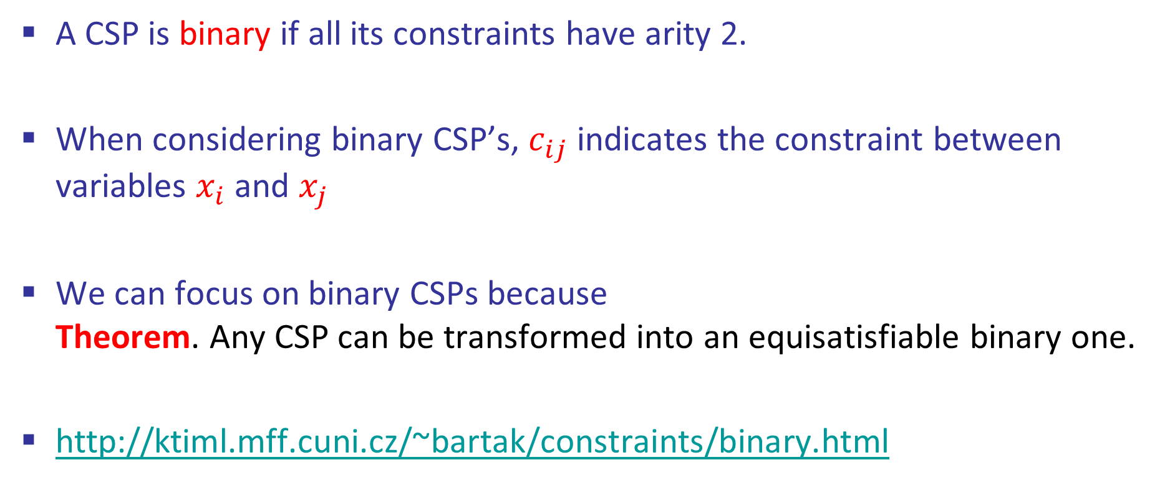
Binary CSPs
A CSP is binary if all its constraints have arity 2.
When considering binary CSP’s, $c_{ij}$ indicates the constraint between variables $x_{i}$ and $x_{j}$
We can focus on binary CSPs because Theorem. Any CSP can be transformed into an equisatisfiable binary one.
http://ktiml.mff.cuni.cz/~bartak/constraints/binary.html

Slide 5
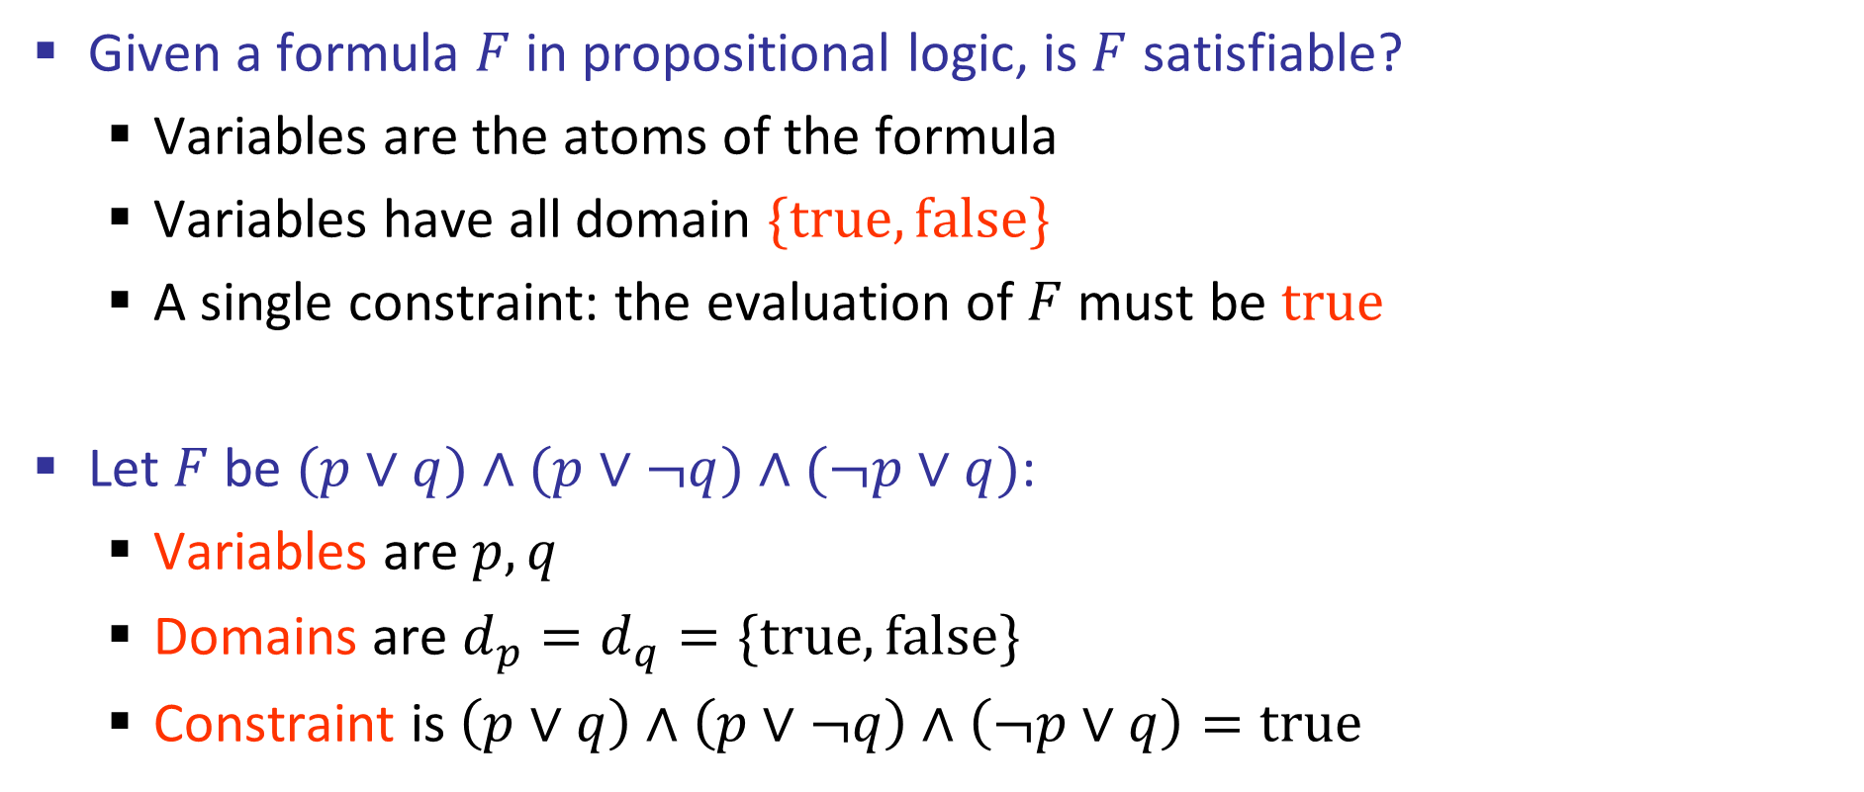
Propositional Satisfiability
Given a formula $F$ in propositional logic, is $F$ satisfiable?
Variables are the atoms of the formula
Variables have all domain $\{true,false\}$
A single constraint: the evaluation of $F$ must be $true$
Let $F$ be $(p∨q)∧(p∨¬q)∧(¬p∨q)$:
Variables are $p,q$
Domains are $d_{p}=d_{q}=\{true,false\}$
Constraint is $\left(p∨q\right)∧\left(p∨¬q\right)∧\left(¬p∨q\right)=true$

Slide 6
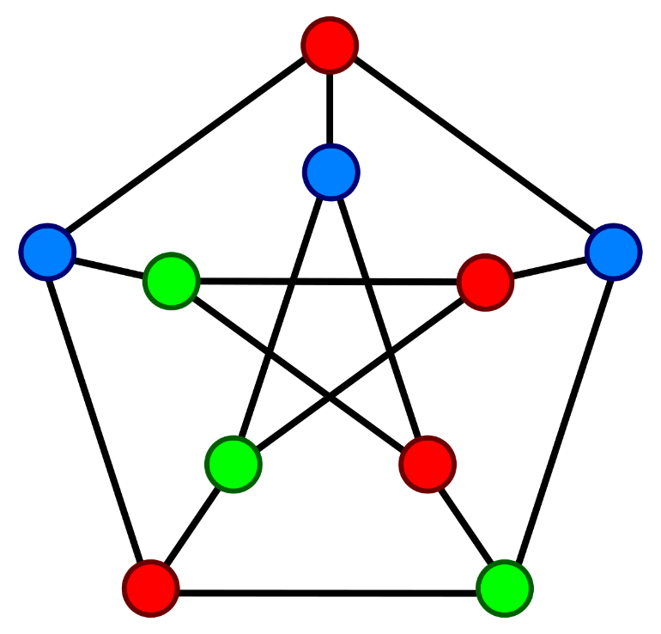
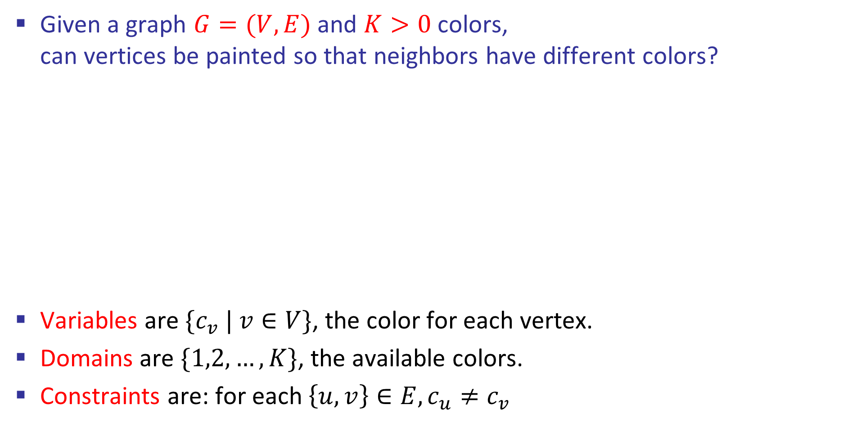
Graph Coloring
Given a graph $G=(V,E)$ and $K>0$ colors, can vertices be painted so that neighbors have different colors?
Variables are ${\{c}_{v} | v∈V\}$, the color for each vertex.
Domains are $\{1,2,…,K\}$, the available colors.
Constraints are: for each $\left\{u,v\right\}∈E,c_{u}≠c_{v}$

Slide 7
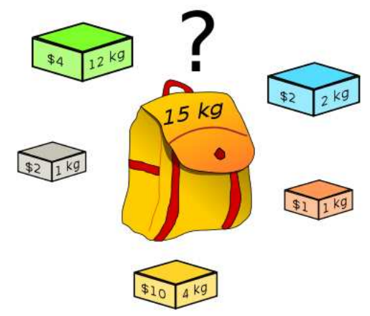
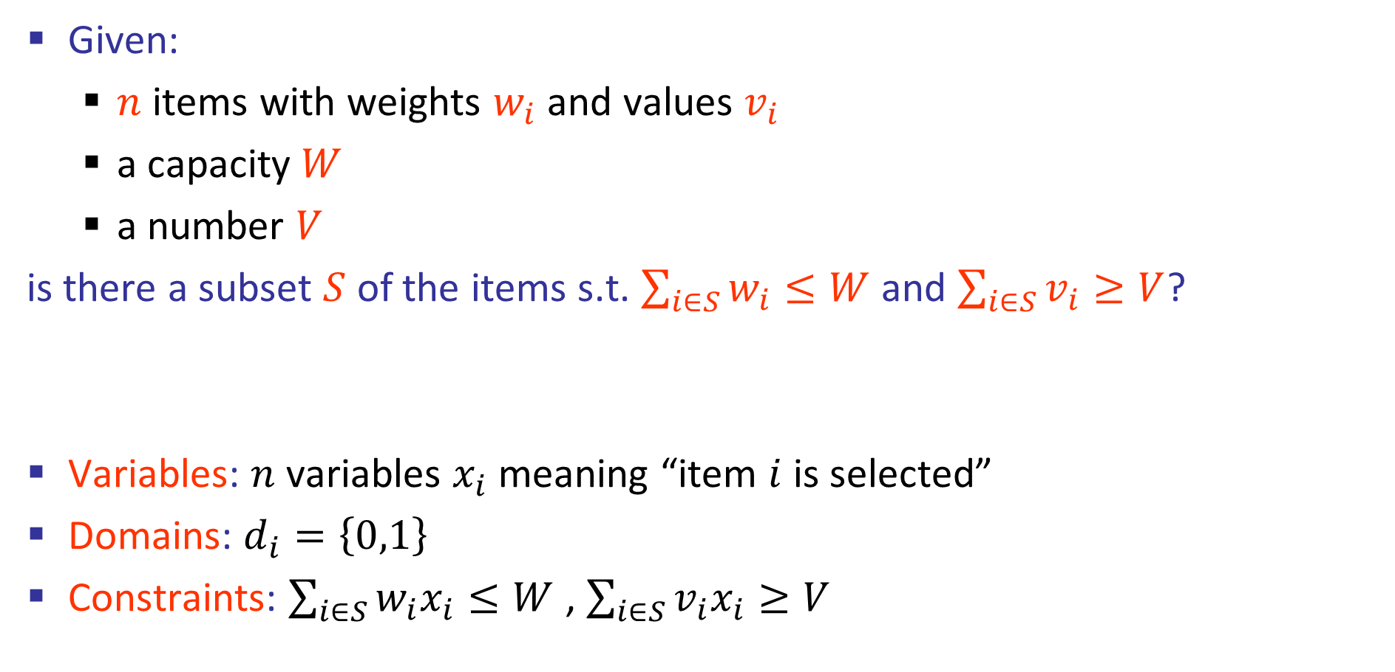
Knapsack
Given:
$n$ items with weights $w_{i}$ and values $v_{i}$
a capacity $W$
a number $V$
is there a subset $S$ of the items s.t. $\sum_{i∈S}{w_{i}}≤W$ and $\sum_{i∈S}{v_{i}}≥V$?
Variables: $n$ variables $x_{i}$ meaning “item $i$ is selected”
Domains: $d_{i}=\left\{0,1\right\}$
Constraints: $\sum_{i∈S}{w_{i}x_{i}}≤W$ , $\sum_{i∈S}{v_{i}x_{i}}≥V$

Slide 8
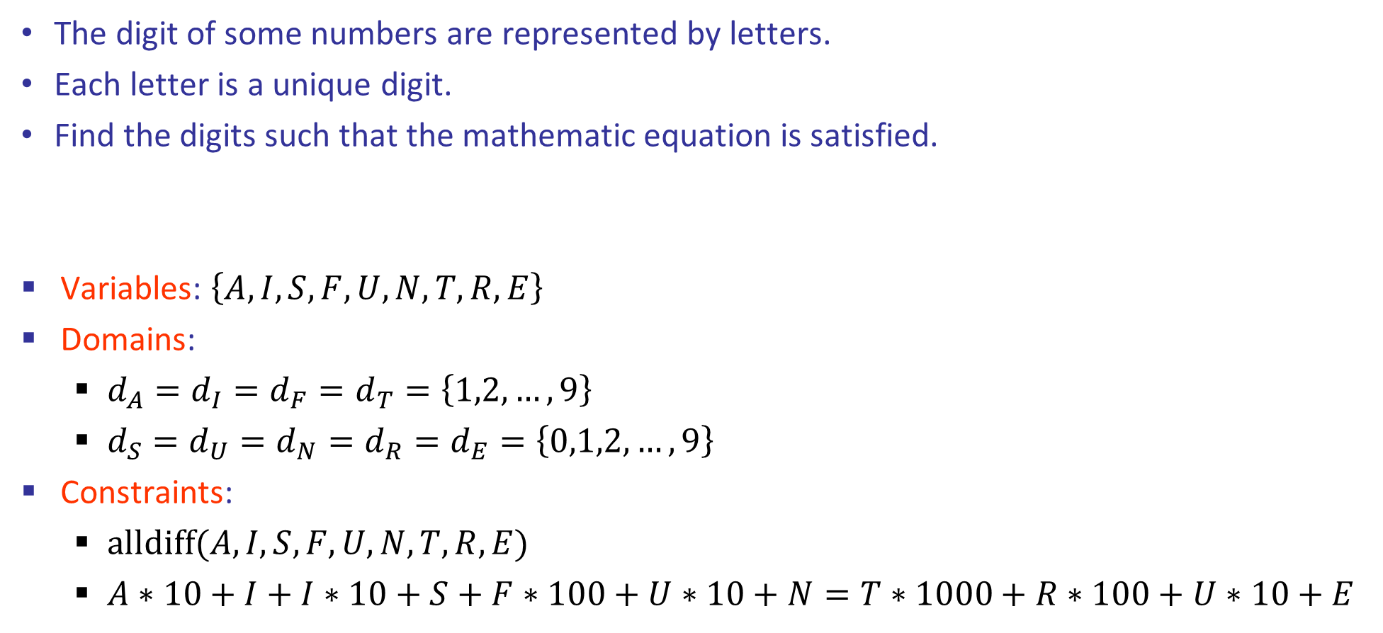
Cryptarithmetic
The digit of some numbers are represented by letters.
Each letter is a unique digit.
Find the digits such that the mathematic equation is satisfied.
Variables: $\left\{A,I,S,F,U,N,T,R,E\right\}$
Domains:
$d_{A}=d_{I}=d_{F}=d_{T}=\left\{1,2,…,9\right\}$
$d_{S}=d_{U}=d_{N}=d_{R}=d_{E}=\left\{0,1,2,…,9\right\}$
Constraints:
$alldiff(A,I,S,F,U,N,T,R,E)$
$A∗10+I+I∗10+S+F∗100+U∗10+N=T∗1000+R∗100+U∗10+E$
AI
+ IS
+ FUN
-----------
= TRUE

Slide 9
Cryptarithmetic
The digit of some numbers are represented by letters.
Each letter is a unique digit.
Find the digits such that the mathematic equation is satisfied.
Variables: $\left\{A,I,S,F,U,N,T,R,E\right\}$
Domains:
$d_{A}=d_{I}=d_{F}=d_{T}=\left\{1,2,…,9\right\}$
$d_{S}=d_{U}=d_{N}=d_{R}=d_{E}=\left\{0,1,2,…,9\right\}$
Constraints:
$alldiff(A,I,S,F,U,N,T,R,E)$
$A∗10+I+I∗10+S+F∗100+U∗10+N=T∗1000+R∗100+U∗10+E$
AI
+ IS
+ FUN
-----------
= TRUE
27
+ 74
+ 985
-----------
= 1086

Slide 10
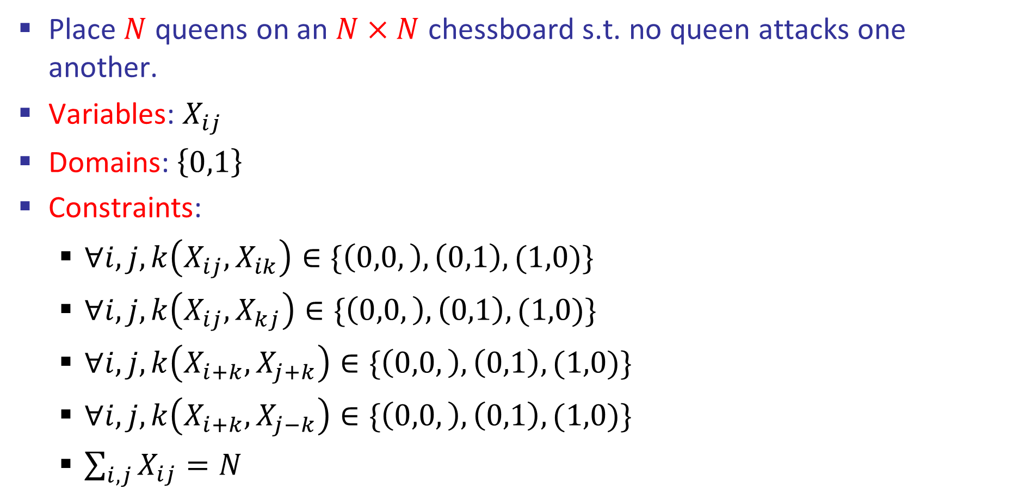
N-Queen
Place $N$ queens on an $N×N$ chessboard s.t. no queen attacks one another.
Variables: $X_{ij}$
Domains:$\left\{0,1\right\}$
Constraints:
$∀i,j,k\left(X_{ij},X_{ik}\right)∈\{\left(0,0,\right),\left(0,1\right),(1,0)\}$
$∀i,j,k\left(X_{ij},X_{kj}\right)∈\{\left(0,0,\right),\left(0,1\right),(1,0)\}$
$∀i,j,k\left(X_{i+k},X_{j+k}\right)∈\{\left(0,0,\right),\left(0,1\right),(1,0)\}$
$∀i,j,k\left(X_{i+k},X_{j−k}\right)∈\{\left(0,0,\right),\left(0,1\right),(1,0)\}$
$\sum_{i,j}{X_{ij}}=N$
 |  | ♛
♛
 |  |  | ♛
 | ♛

Slide 11
Complexity
Theorem: Solving a CSP is an NP-complete problem
Proof:
It is in NP, because one can check a solution in polynomial time
It is NP-hard, as there is a reduction e.g. from Prop. Satisfiability
(which is known to be NP-complete)
For any CSP, there are instances that require exp time. Can we solve real life instances in reasonable time?

Slide 12
Approaches to Problem Solving
Specialized algorithms
Costly to design, implement and extend.
Declarative methodology
Choose a problem-solving framework (what is my language?)
Model the problem (what is a solution?)
Define variables.
Define constraints.
Solve it (with an off-the-shelf solver).

Slide 13
Problem-Solving Frameworks
Problem-solving frameworks:
Constraint Programming (CP)
Linear Programming (LP)
Propositional Satisfiability (SAT)
…
For each of these frameworks:
Modeling techniques
Inner workings of solvers.

Slide 14
Links
https://en.wikipedia.org/wiki/List_of_optimization_software
https://developers.google.com/optimization/introduction/overview
https://www.gecode.org/
https://www.minizinc.org/
https://www.gurobi.com/

